Slide 1

Lecture 6: CSS Box Model and Layout
Open Source Web Software

Slide 2
In the last lecture
CSS Basics
CSS(Cascading Style Sheets): defines style of text.
Advantages
Types of selections
type selector
universal selector
ID selector
class selector
attribute selector
pseudo-class

Slide 3
In the last lecture
There are three ways of inserting CSS code inside of your HTML document
external style sheet
internal style sheet
inline
CSS properties
Background
Font
Text
Border
Table
List

Slide 4
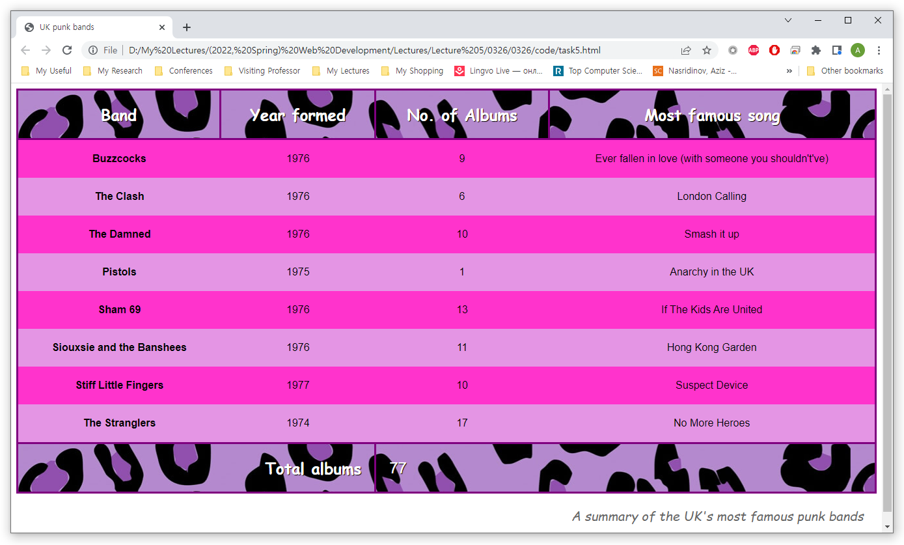
In the last lecture
Practice

Slide 5
Table of Contents
Part 3.
CSS Placement
Part 4.
CSS Layout
Part 1.
CSS Box Model
Part 2.
CSS Display

Slide 6
CSS box model
PART 1

Slide 7
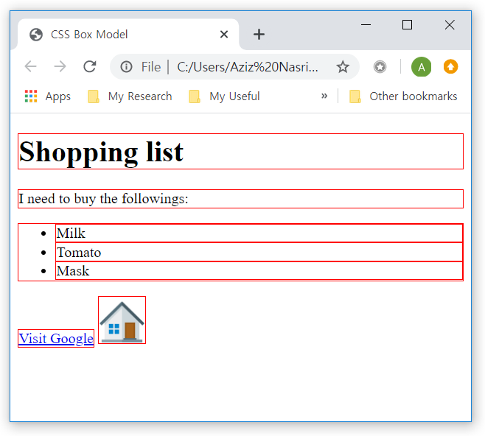
CSS Box Model
All HTML elements can be considered as boxes
<!DOCTYPE html>
<html>
<head>
<title>CSS Box Model</title>
<style media="screen">
h1, p, ul, li, a, img{border: 1px solid red;}
</style>
</head>
<body>
<h1>Shopping list</h1>
<p>I need to buy the followings:</p>
<ul>
<li>Milk</li>
<li>Tomato</li>
<li>Mask</li>
</ul>
<a href="www.google.com">Visit Google</a>
<img src="home.png" width="50" height="50">
</body>
</html>

Slide 8
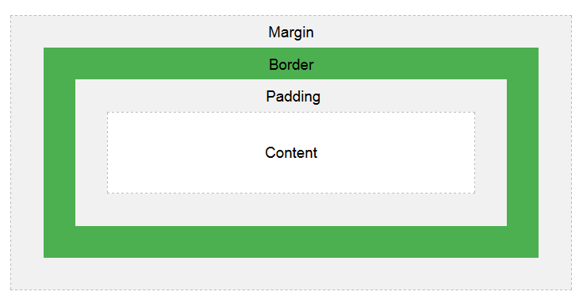
CSS Box Model
CSS Box Model consists of the followings:
Actual content, padding, border, margin

Slide 9
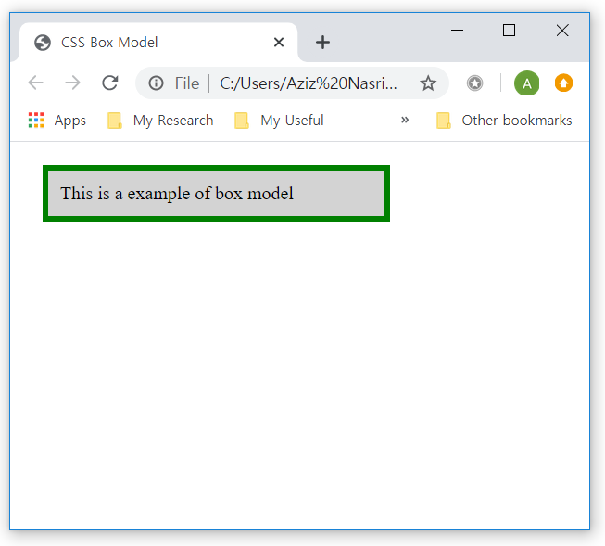
CSS Box Model
CSS Box Model example
<!DOCTYPE html>
<html>
<head>
<title>CSS Box Model</title>
<style>
div {
background-color: lightgrey;
border: 5px solid green;
padding: 10px;
margin: 20px;
}
</style>
</head>
<body>
<div>This is a example of box model</div>
</body>
</html>

Slide 10
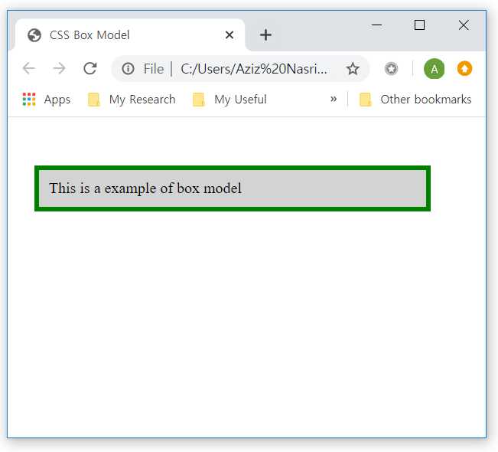
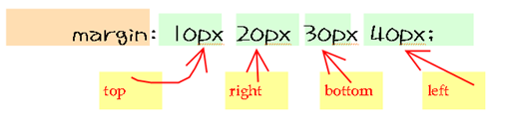
CSS Box Model
CSS Box Model
How to specify all sides of box model: top, right, left and bottom
<!DOCTYPE html>
<html lang="en" dir="ltr">
<head>
<title>CSS Box Model</title>
<style media="screen">
div {
background-color: lightgrey;
border: 5px solid green;
padding: 10px;
margin-top: 50px;
margin-left: 20px;
}
</style>
</head>
<body>
<div>This is a example of box model</div>
</body>
</html>

Slide 11
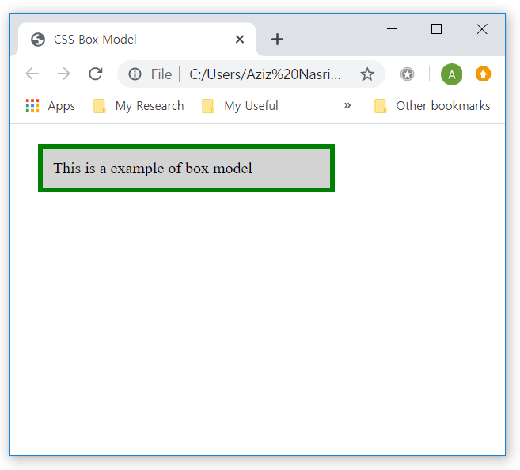
CSS Box Model
Width and Height of an Element
Set the width and height of an element correctly in all browsers
<!DOCTYPE html>
<html>
<head>
<title>CSS Box Model</title>
<style media="screen">
div {
width: 200px;
background-color: lightgrey;
border: 5px solid green;
padding: 10px;
margin: 20px;
}
</style>
</head>
<body>
<div>This is a example of box model</div>
</body>
</html>

Slide 12
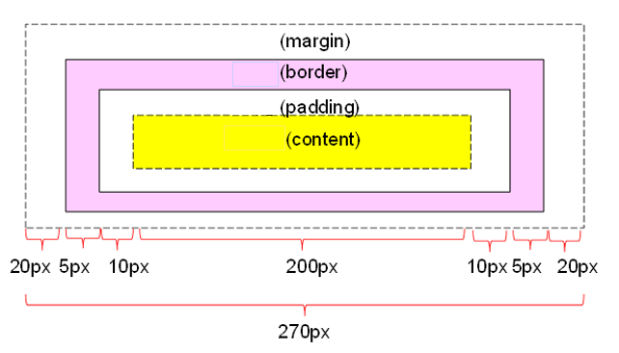
CSS Box Model
Width and height of an Element
How to calculate box size

Slide 13
Css Display
Part 2

Slide 14
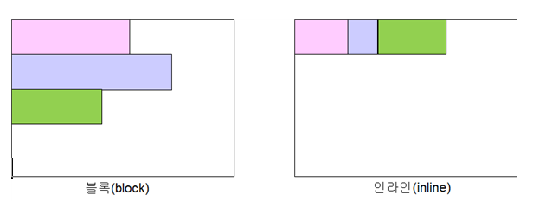
CSS Display
Block element
Takes up a whole line of the screen.
Inline elements
Placed one after the other in a row. It takes up only as much width as needed in the current line.

Slide 15
CSS Display
Example of block and inline element
<!DOCTYPE html>
<html>
<head>
<title>CSS Box Model</title>
<style>
h1, p, ul, li, a, img{border: 1px solid red;}
</style>
</head>
<body>
<h1>Shopping list</h1>
<p>I need to buy the followings:</p>
<ul>
<li>Milk</li>
<li>Tomato</li>
<li>Mask</li>
</ul>
<a href="www.google.com">Visit Google</a>
<img src="home.png" width="50" height="50">
</body>
</html>

Slide 16
CSS Display
Set/override display property in CSS
Make it block element
display: block;
Make it inline element
display: inline;
Remove element
display: none;
Hide element
visibility: hidden;
Make it inline element with OPTIONS
display: inline-block;

Slide 17
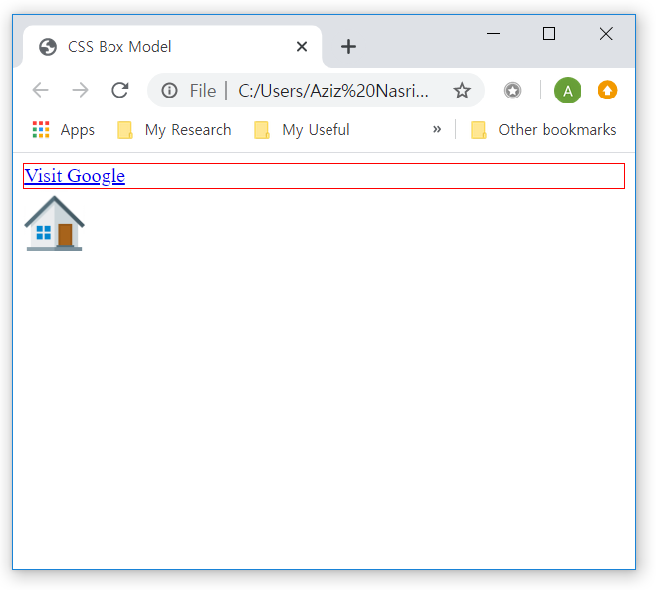
CSS Display
display: block
Make it block element
<!DOCTYPE html>
<html>
<head>
<title>CSS Box Model</title>
<style>
a{
display: block;
border: 1px solid red;
}
</style>
</head>
<body>
<a href="www.google.com">Visit Google</a>
<img src="home.png" width="50" height="50">
</body>
</html>

Slide 18
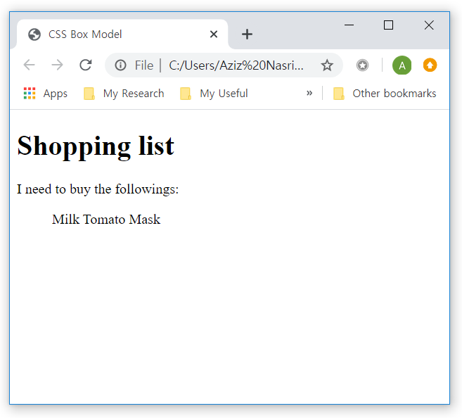
CSS Display
display: inline
Make it inline element
<!DOCTYPE html>
<html>
<head>
<title>CSS Box Model</title>
<style>
li{
display: inline;
border: 1px solid red;
}
</style>
</head>
<body>
<h1>Shopping list</h1>
<p>I need to buy the followings:</p>
<ul>
<li>Milk</li>
<li>Tomato</li>
<li>Mask</li>
</ul> </body>
</html>

Slide 19
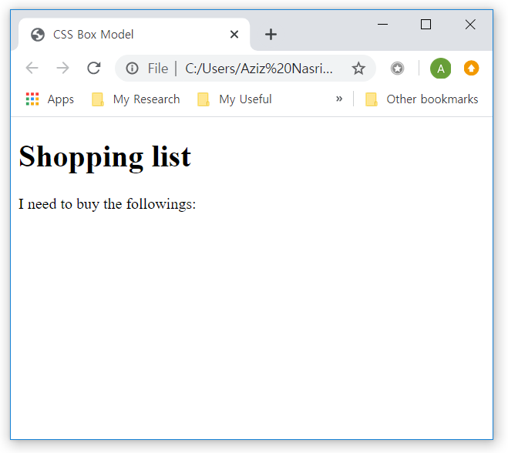
CSS Display
display: none
Remove element
<!DOCTYPE html>
<html>
<head>
<title>CSS Box Model</title>
<style>
li{
display: none;
border: 1px solid red;
}
</style>
</head>
<body>
<h1>Shopping list</h1>
<p>I need to buy the followings:</p>
<ul>
<li>Milk</li>
<li>Tomato</li>
<li>Mask</li>
</ul>
</body>
</html>

Slide 20
CSS Display
visibility: hidden
Hide element
<!DOCTYPE html>
<html>
<head>
<title>CSS Box Model</title>
<style>
li{
visibility:hidden;
border: 1px solid red;
}
</style>
</head>
<body>
<h1>Shopping list</h1>
<p>I need to buy the followings:</p>
<ul>
<li>Milk</li>
<li>Tomato</li>
<li>Mask</li>
</ul>
</body>
</html>

Slide 21
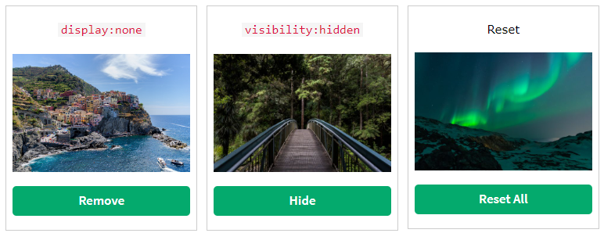

CSS Display
Difference between display: none and visibility: hidden
Hiding an element can be done by setting the display property to none
The page will be displayed as if the element is not there
Element is completely gone

Slide 22
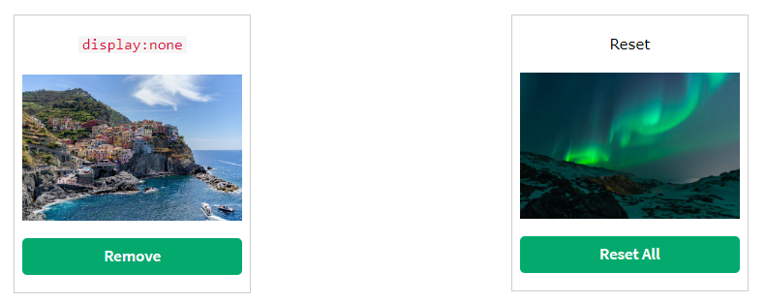
CSS Display
Difference between display: none and visibility: hidden
visibility:hidden; also hides an element
However, the element will still take up the same space as before
The element is hidden, but still affect the layout

Slide 23
CSS Display
display:inline-block
Make it inline elements with OPTIONS
Compared to display: inline, display: inline-block allows to set a width and height on the element
Also, with display: inline-block, the top and bottom margins/paddings are respected
But with display: inline they are not

Slide 24
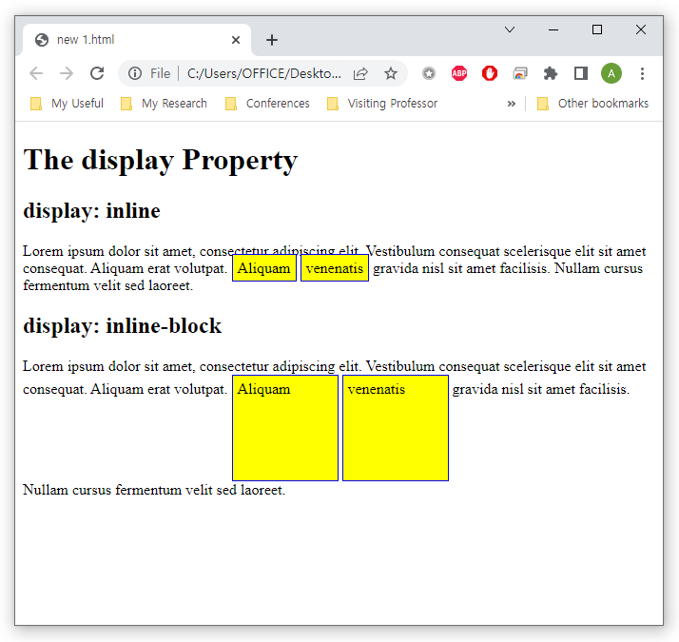
CSS Display
display:inline-block
Difference between inline-block and inline
<style>
span.a {
display: inline;
width: 100px;
height: 100px;
padding: 5px;
border: 1px solid blue;
background-color: yellow;
}
span.b {
display: inline-block;
width: 100px;
height: 100px;
padding: 5px;
border: 1px solid blue;
background-color: yellow;
}
</style>

Slide 25
CSS Display
display:inline-block
Compared to display: block, display: inline-block does not add a line-break after the element
So the element can sit next to other elements

Slide 26
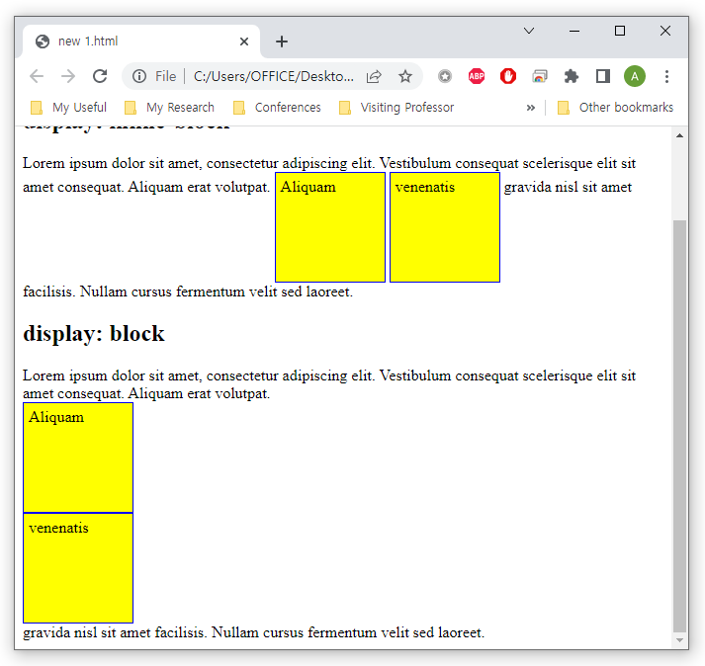
CSS Display
display:inline-block
Difference between inline-block and block
<style>
span.b {
display: inline-block;
width: 100px;
height: 100px;
padding: 5px;
border: 1px solid blue;
background-color: yellow;
}
span.c {
display: block;
width: 100px;
height: 100px;
padding: 5px;
border: 1px solid blue;
background-color: yellow;
}
</style>

Slide 27
CSS Placement
Part 3

Slide 28
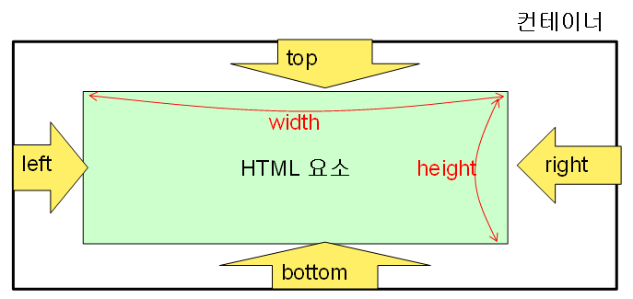
CSS Placement
Decided by property top, bottom, left, right
element
However, these properties will not work unless the position property is set first.

Slide 29
CSS Placement
The position property specifies the type of positioning method used for an element
Static positioning
Placement along normal flow
Relative positioning
The normal position is the reference point.
Absolute positioning
The origin of the container is the reference point.
Fixed positioning
The origin of the window becomes the reference point

Slide 30
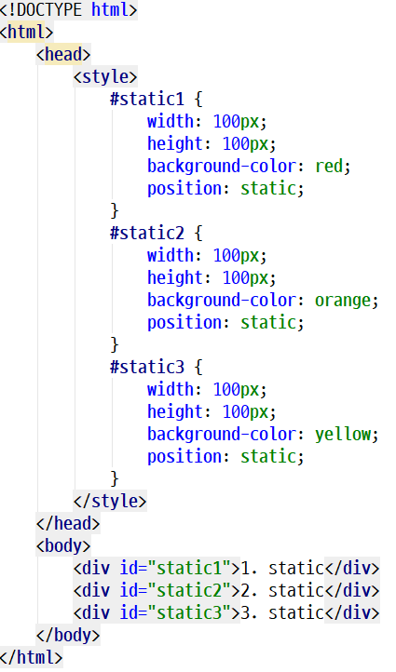
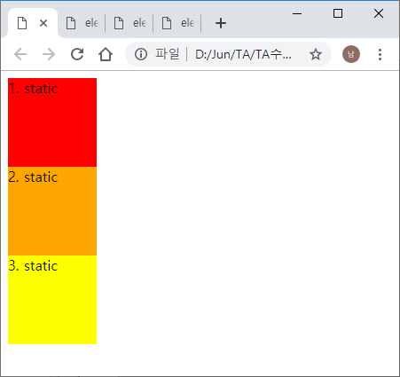
CSS Placement
Static positioning

Slide 31
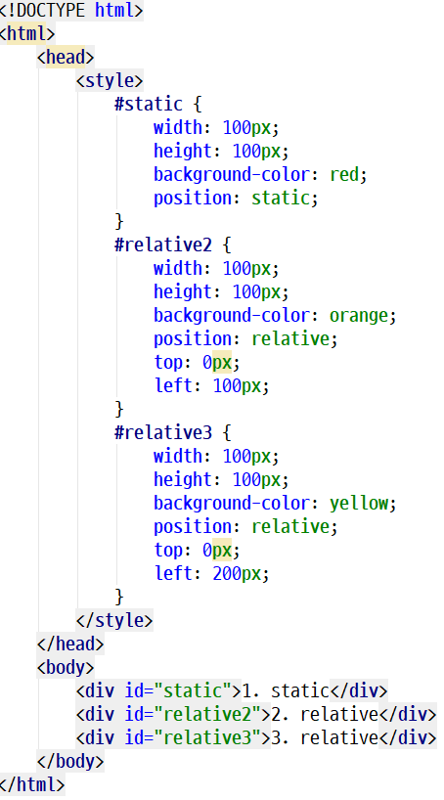
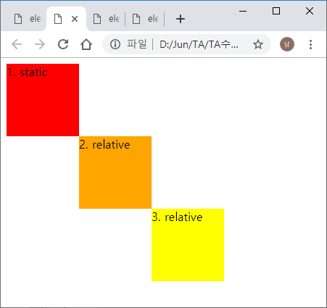
CSS Placement
Relative positioning

Slide 32
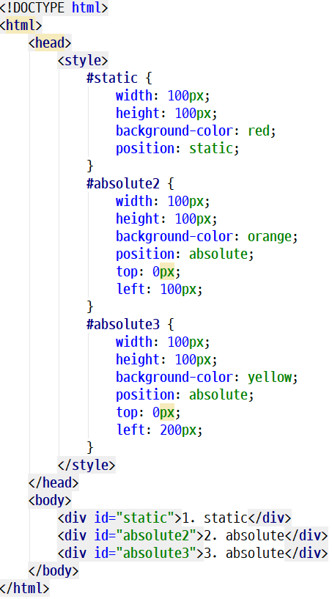
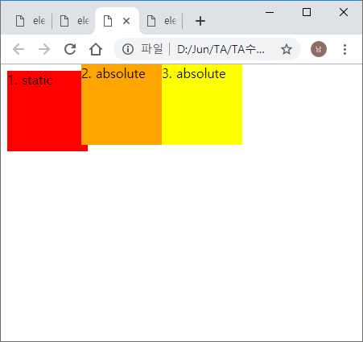
CSS Placement
Absolute positioning

Slide 33
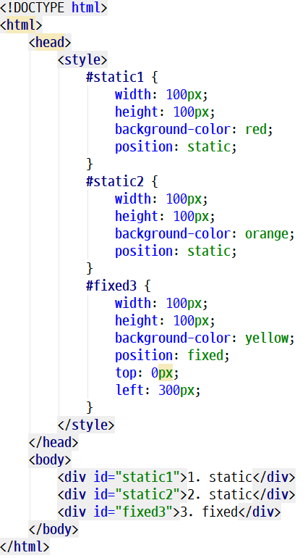
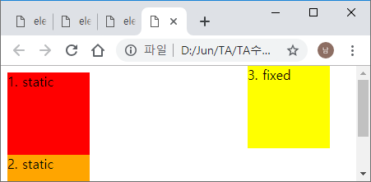
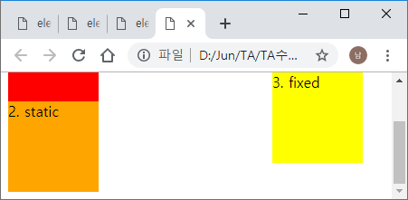
CSS Placement
Fixed positioning

Slide 34
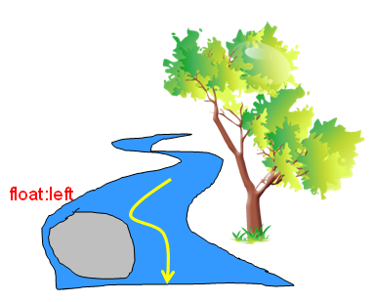
CSS Placement
Specify a style of flowing other content around one content

Slide 35
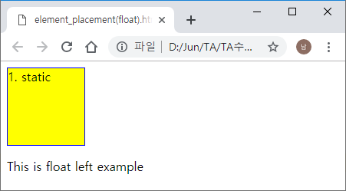
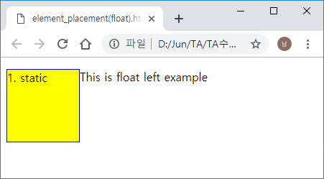
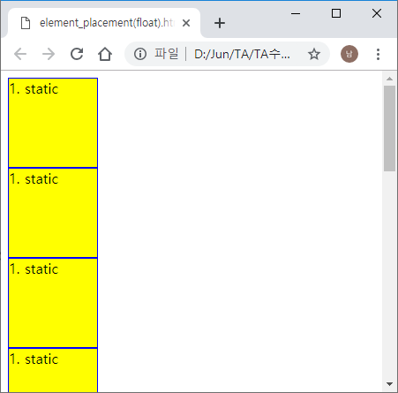
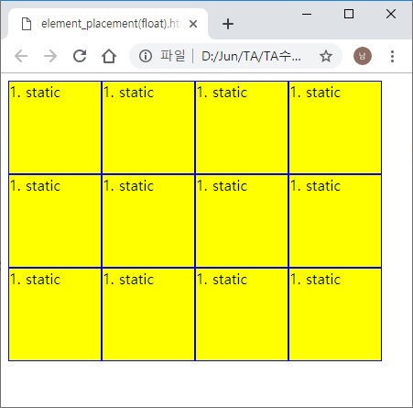
CSS Placement
Example of float property
ex 1
ex 2
default
float : left

Slide 36
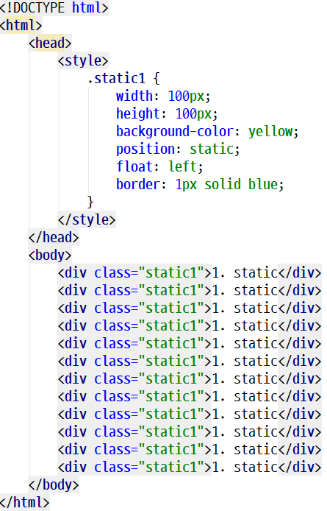
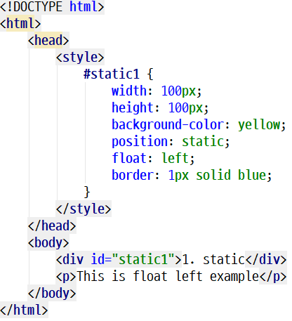
CSS Placement
Example of float property
ex 2
ex 1

Slide 37
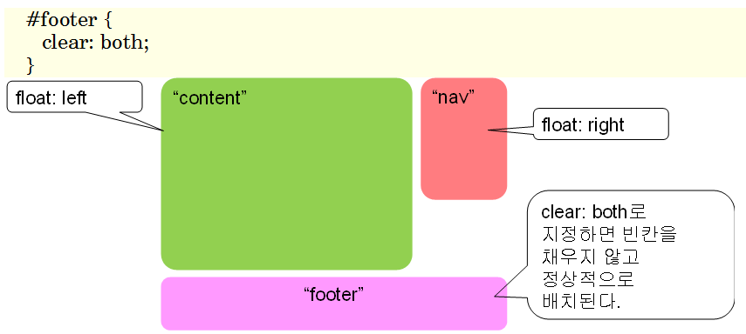
CSS Placement
Clear property of float
Used to break the float property..
If set to both, it is normally placed without filling in the blanks.

Slide 38
CSS Layout
Part 4

Slide 39
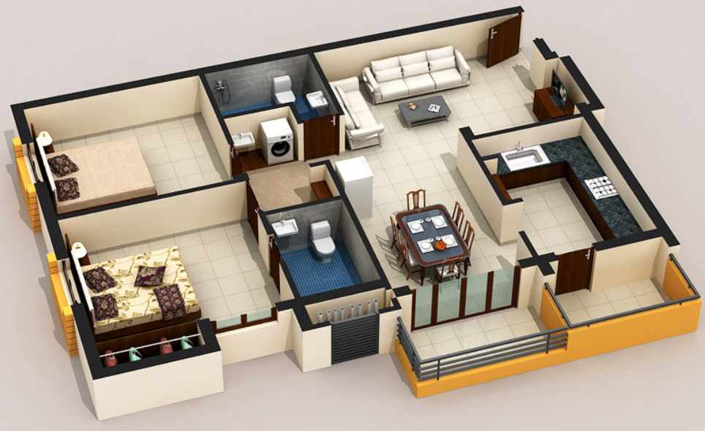
CSS Layout
Determining the location, size, etc. of HTML elements in a web page
It is similar to the arrangement of furniture in the house.

Slide 40
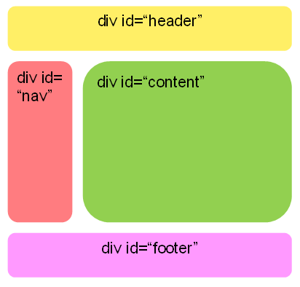
CSS Layout
Layout used by <div>

Slide 41
CSS Layout
Example of CSS layoyt
<!DOCTYPE html>
<html>
<head>
<title>My Blog Page</title>
<style>
#header {
background-color: yellow;
width: 100%;
height: 50px;
}
#nav {
width: 30%;
background-color: red;
height: 100px;
float: left;
}
#content {
width: 70%;
background-color: blue;
float: right;
height: 100px;
}
#footer {
background-color: aqua;
width: 100%;
height: 50px;
clear: both;
}
</style>
</head>
<body>
<div id="wrapper">
<div id="header"> header </div>
<div id="nav"> nav </div>
<div id="content"> content </div>
<div id="footer"> footer </div>
</div>
</body>
</html>

Slide 42
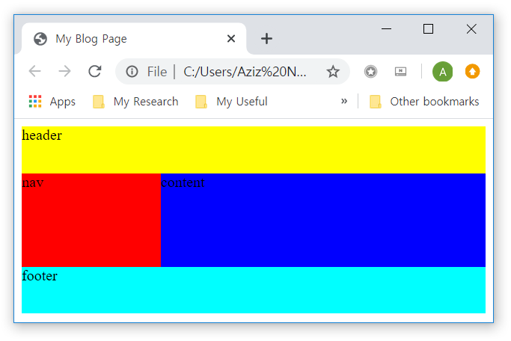
CSS Layout
Example of CSS layoyt

Slide 43
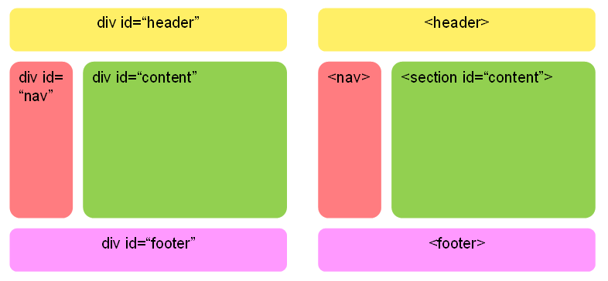
CSS Layout
Semantic layout element

Slide 44
Summary and Discussions
CSS Box Model
CSS Box Model consists of the followings:
margins, borders, padding, and the actual content
Width and height of an Element
How to calculate box size

Slide 45
Summary and Discussions
CSS Display
display: block
display: inline
display: none
visibility: hidden
display: inline-block
The position property specifies the type of positioning method used for an element
Static positioning
Relative positioning
Absolute positioning
Fixed positioning

Slide 46
Summary and Discussions
CSS Layout

Slide 47
Practice
Part 5

Slide 48
CSS Box Model
CSS Box Model consists of the followings:
margins, borders, padding, and the actual content.

Slide 49
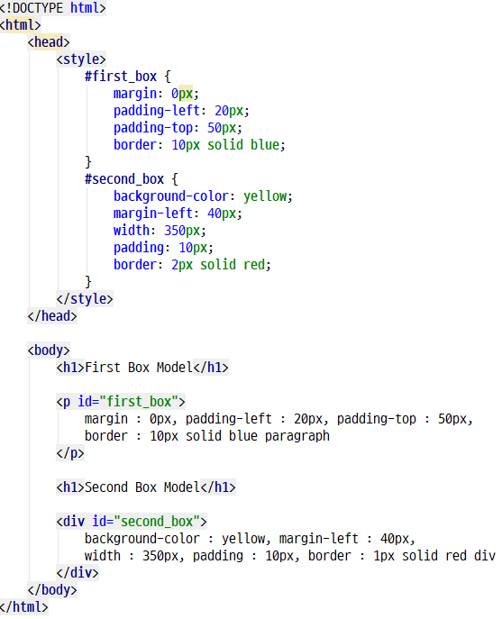
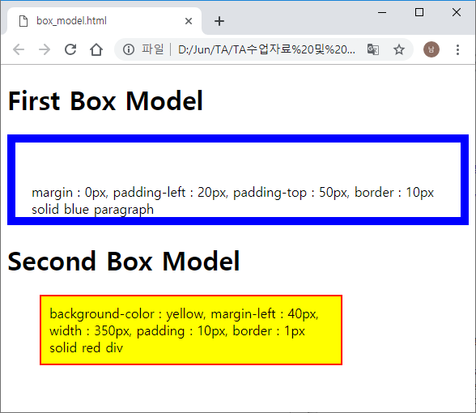
CSS Box Model
Practice 1

Slide 50
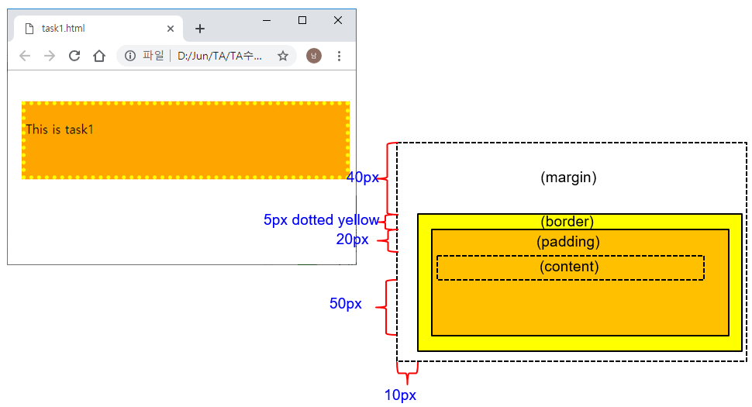
CSS Box Model
Task 1
Create this webpage
Use this margin and padding
values

Slide 51
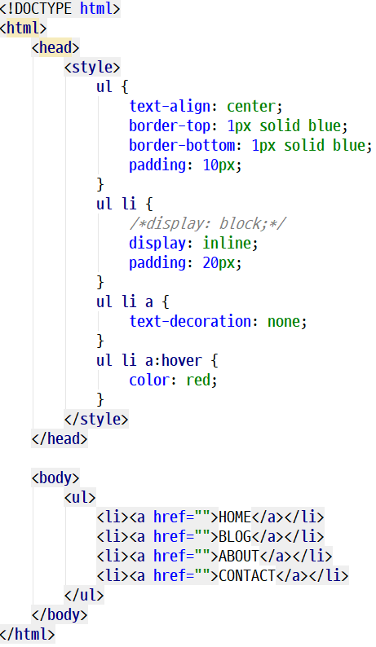
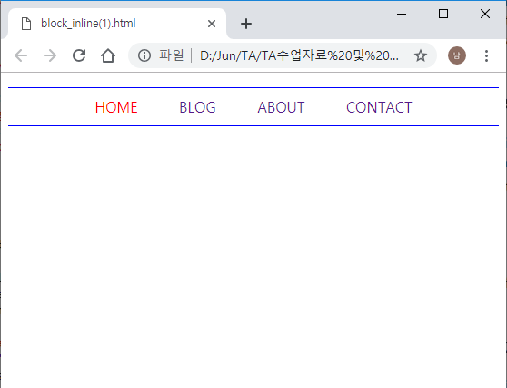

CSS Display
Practice 2
display : inline

Slide 52
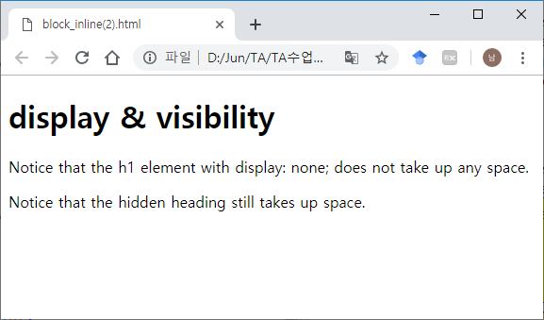
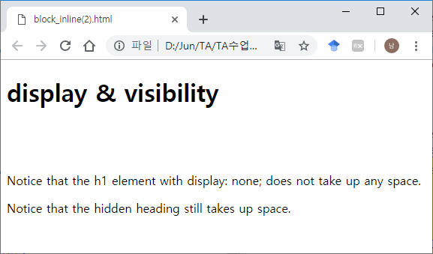
CSS Display
Practice 2
Difference between display:none and visibility: hidden
visibility : hidden
hidden on screen
display : none
considered not present

Slide 53
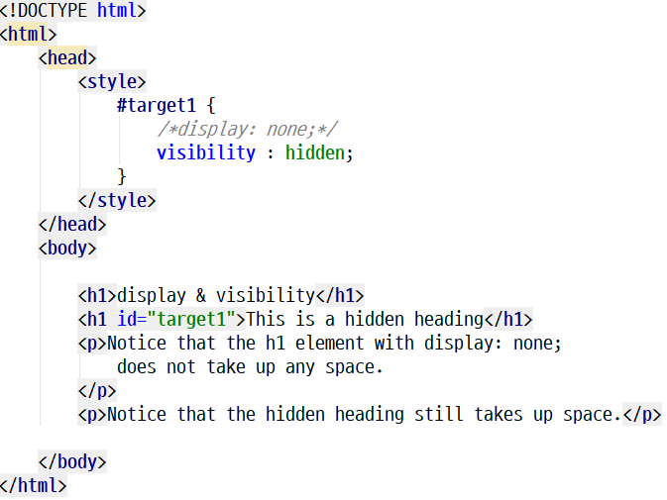
CSS Display
Practice 2

Slide 54
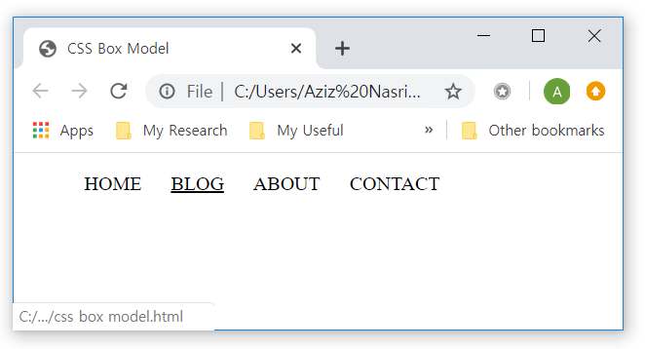
CSS Display
Task 2
Create the following menu navigation
Use a:hover pseudo selector
Use display: inline-block

Slide 55
CSS Placement
Practice 3
Static positioning

Slide 56
CSS Placement
Practice 3
Relative positioning

Slide 57
CSS Placement
Practice 3
Absolute positioning

Slide 58
CSS Placement
Practice 3
Fixed positioning

Slide 59
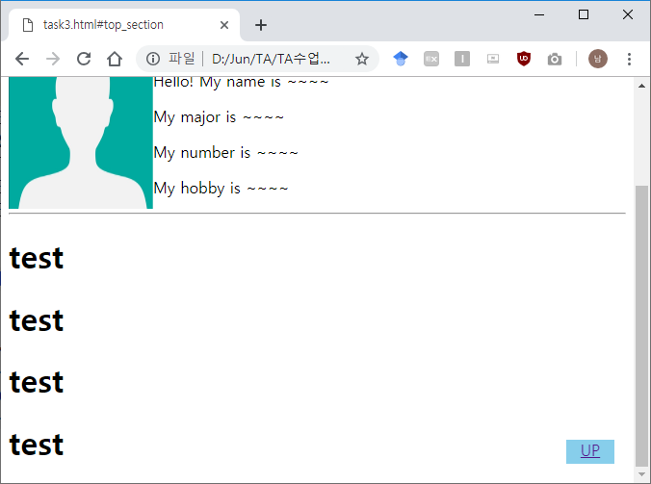
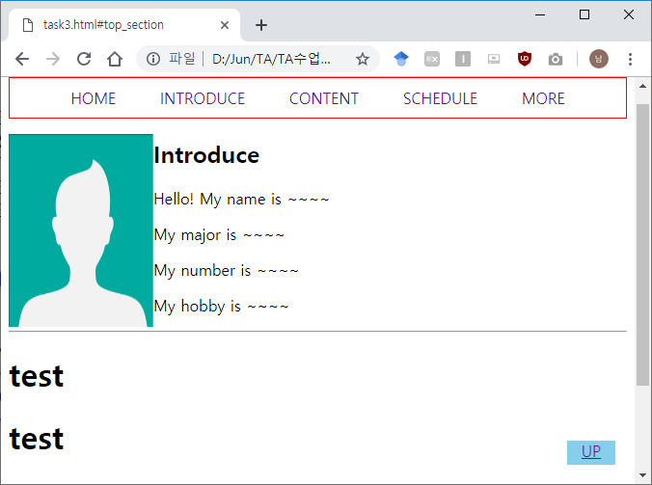
CSS Placement
Task 3
Use position: fixed for up link
Use ID selector to jump to top of the webpage
When you click on up link (<a href=“#top_section”>UP</a>), you must jump to top of the webpage (connect to <ul id=“top_section”>)
UP 클릭 시, 맨 위 리스트로 이동

Slide 60
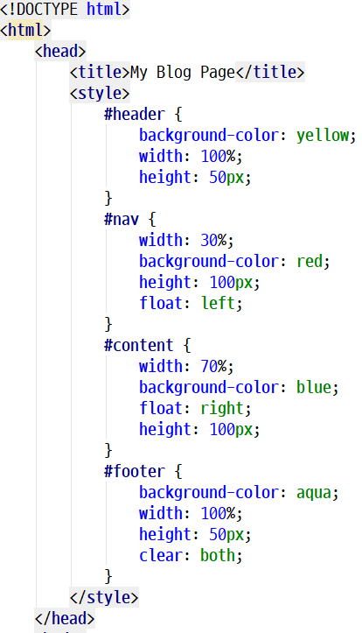


CSS Layout
Practice 4

Slide 61

CSS Layout
Task 4
header
nav1
nav2
content
footer

Slide 62






CSS Layout
Task 4
The rest of the menu will also be applied.

Slide 63
See you next time!
Questions?

